Slide 1
New Officials Training
Session 1
July 9, 2024

Slide 2
WELCOME TO NEW OFFICIALS TRAINING OF THE DALLAS VOLLEYBALL OFFICIALS CHAPTER FOR THE 2024-25 SEASON
We are glad you have decided to take this step to officiate volleyball in the DVOC

Slide 3
RESPECT – whether this is respect for the game, the Laws of the Game, the people involved,
or the rules and regulations, a referee must always be respectful.
EMPATHY – the best referee is not the ones who can turn off their emotions but the one
who understands the needs of the match.
FITNESS – a referee needs to be able to keep up with the match, so physical fitness is an absolute
must. Don’t forget, the most controversial moments tend to happen in the final minutes. You need to
be ready for anything at any time.
EVALUATION – It is important to be able to evaluate specific in-match incidents as well as the
general feeling of a game. The best referees will adjust their approach depending on the needs of a
particular game.
RELIABILITY – The referee needs to be a dependable presence both on and off the field. They need
to take control when major incidents (like serious injuries) occur and when sticking to the rules. Off
the field, they need to continue this level of professionalism.
EDUCATION – There is always room to develop and the best referees are the ones who are always
willing to learn. In order to be the best, you need to be ready to grow and take advice from others.
EXCELLENCE – Above all else, the basic value of refereeing is the desire to achieve excellence.

Slide 4
Becoming a qualified official
Have a calm demeanor – this means you have a calm within yourself that allows you to project your calmness onto the game. If you are calm, your co-officials are calm, the coaches and players pick up on this. You have a sense of control that earns you respect.
Avoid confrontations at all possible situations and learn how to address situations that reflect your calming demeanor
Learn to be approachable by your co-officials, line judges, players, coaches and the crew at the score table.

Slide 5
Have a good appearance on the court. This includes how your uniform looks and arriving on time. Remember you won’t get a second chance to make that first impression.
Have confidence – this is hard to explain, and you will struggle with this as you begin your officiating career; however, the quicker you gain confidence in all aspects of officiating the faster your partners, coaches, players and the assigner will notice.
As an example, if you are the R2 and your R1 knows you will take care of the net, they can focus on the duties of the R1.

Slide 6
Becoming a Good Official
Don’t run off once the match is over. Ask for, listen and accept the critique the veteran officials give you. Take notes and work on those things that were identified as areas for improvement.
Continue to learn and recognize we all make mistakes; however, you will be provided with opportunities to showcase your game management when these situations occur. How you do that and handling those issues correctly will gain respect from your fellow officials, coaches and players. How you do this will set you apart from your fellow officials.

Slide 7
Becoming a GREAT Official
You have to want to be a great official. It’s in the heart. Without this desire you won’t be a great official.
The other way to become a great official is you have to work matches. Each match you work will give you an opportunity to get better and the more matches you work (correctly) the better you get. It does you no good to work matches using poor mechanics with a poor attitude.

Slide 8
What to expect this year
You will be given every opportunity to improve your skills as an official. Your growth and improvement will be a direct correlation to your availability for assignments and your willingness to learn. We are here to help you with your growth as are most members of our chapter.
All you must do is be willing and ask for assistance. If you don’t ask no one will know!

Slide 9
7 Essentials of a new official
Learn how to administer a coin toss before a match
Learn how to fill out a line- up card before each set
Learn how to administer a line up check during a set
Learn how to focus on watching the net and centerline and NOT the ball
Learn how to administer substitutions
Learn how to administer a timeout
Learn how to communicate (verbal and non verbal) with coaches, players and the table personnel

Slide 10
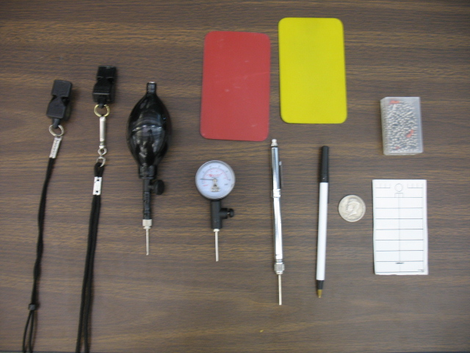
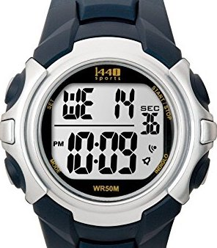
OFFICIAL’S EQUIPMENT
Equipment needed includes
but is not limited to:
A whistle attached to a lanyard and a
spare whistle. (Black is recommended).
A ball pressure gauge.
A ball pump
Red and yellow conduct cards
Net chain to measure net height
Pen or pencil
A coin to flip to determine serve
Line-up cards
A watch
Volleyball referees need specific
equipment to officiate a match.

Slide 11
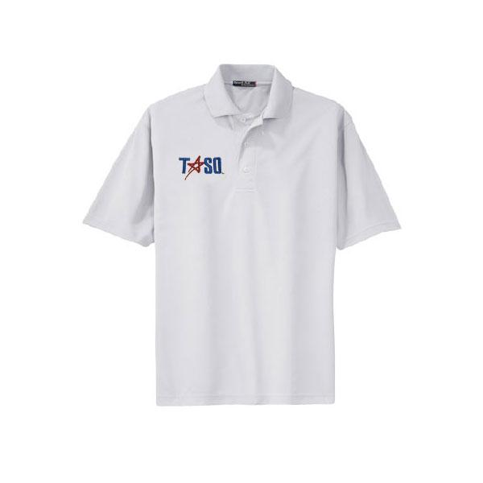
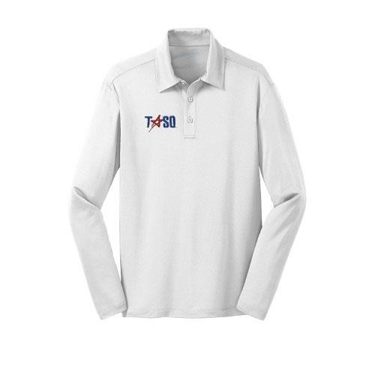
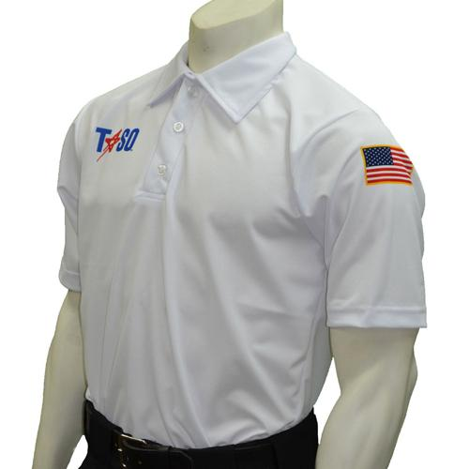
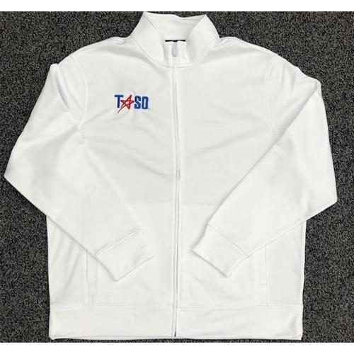
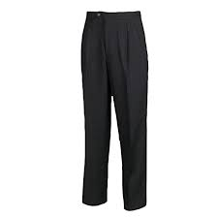
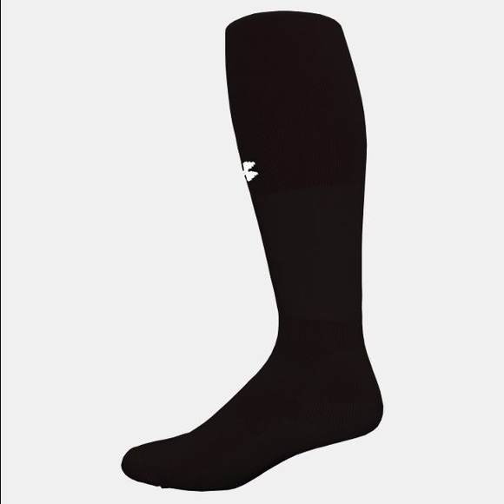
TASO APPROVED
JACKET
TASO APPROVED
SWEATSHIRT
TASO APPROVED
SHIRT With or
Without Pocket
Black Socks
Black Pants
Black
Athletic
Shoes

Slide 13
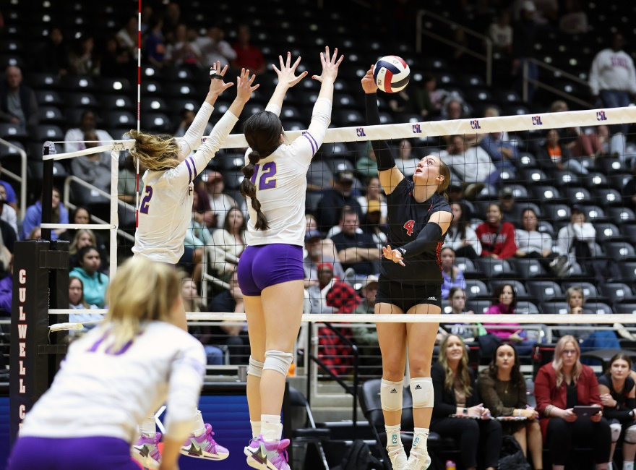
The Game
Volleyball – Game played by two teams of six players each, in which an inflated ball is volleyed over a high net. Each team tries to make the ball touch the court within the opposing side’s playing area before it can be returned. A team is allowed to touch the ball three times before returning it.

Slide 14
Some Common Terms
Serve - Contact with the ball from behind the serving line into the playing area of the opponent. This serve is the beginning/start of every point.
Receive - The skill of passing the ball when receiving the serve.
Set - Using predominantly your hands, but also your arms to direct the ball to an attacker.
Attack – Any action other than a block or serve that directs the ball toward the opponent’s court

Slide 15
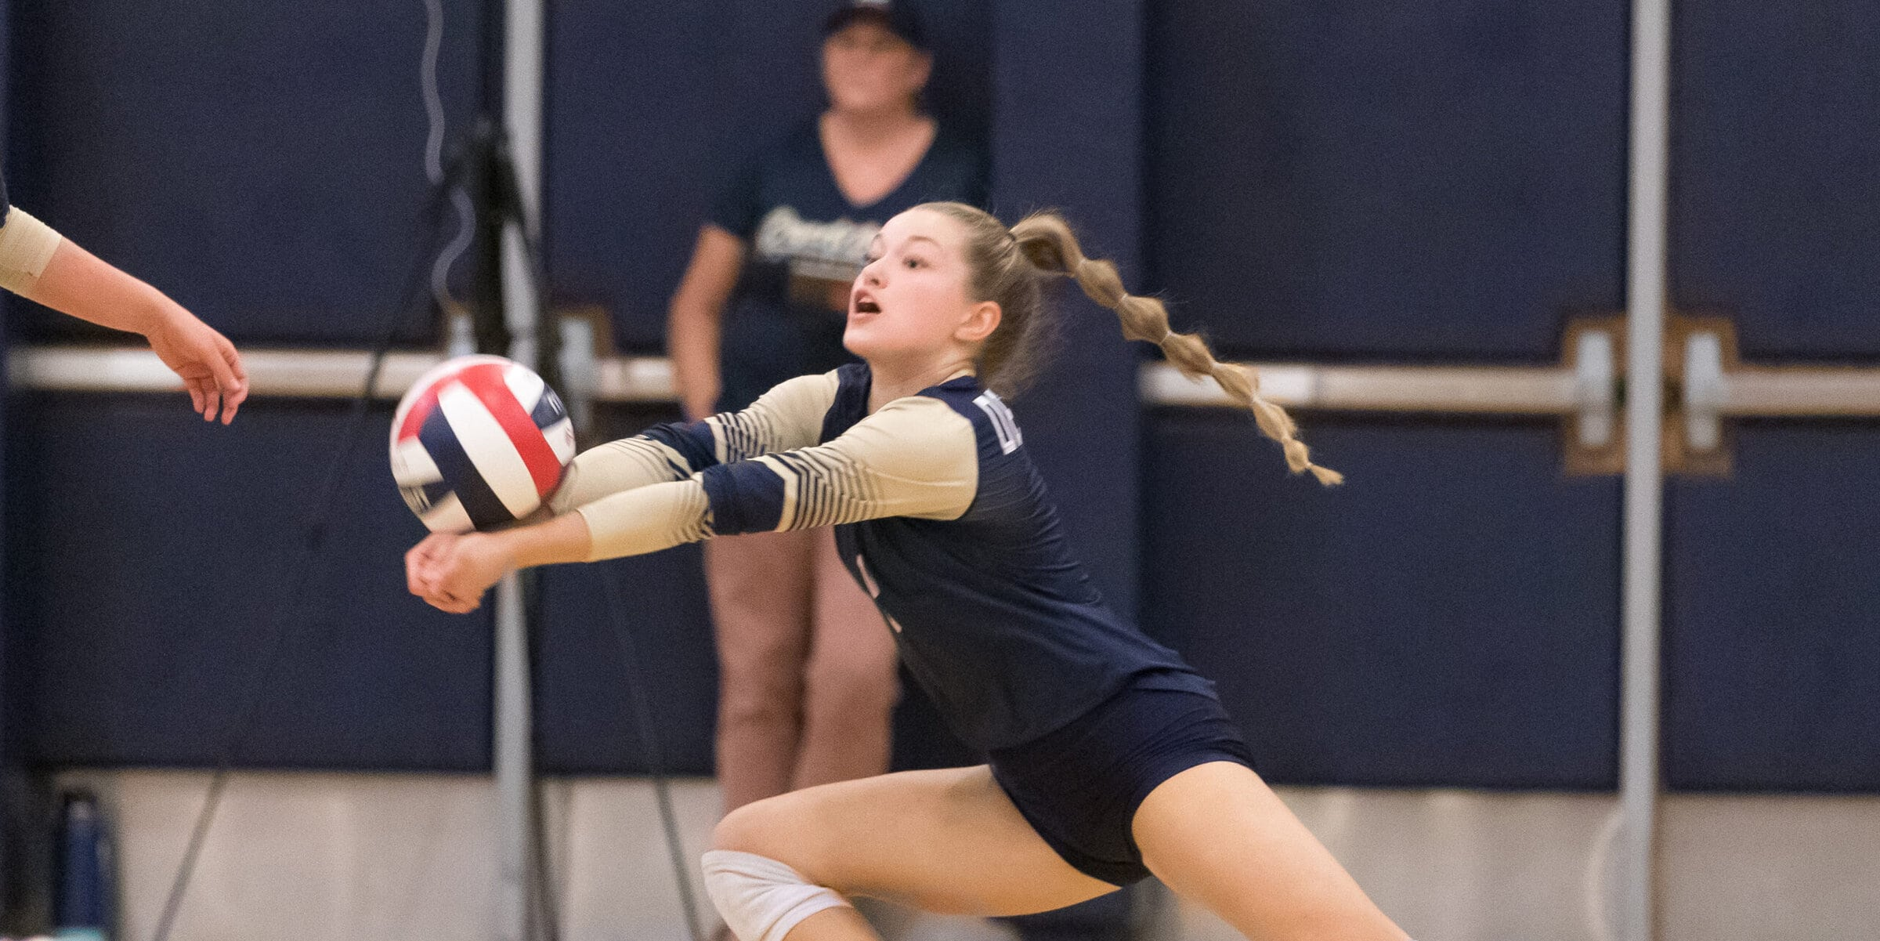
Block – Player(s) that attempt to stop an attack by using their hands and arms to deflect the ball coming from the opponent by reaching higher than the top of the net at the moment of contact.
Dig - The skill of defenders to pass a hard hit ball to keep it from touching the floor in the playing area on their side of the court.

Slide 16
Varsity Level Match
Shall consist of the best three-of-five sets.
The first team to win three sets shall be the winner of the match.
Rally scoring – when a team commits a fault, the result is a loss of rally and the opponent shall receive a point.
First four sets shall be 25 points (no cap).
The fifth and deciding set shall be 15 points (no cap).
Team must win by at least two points.

Slide 17
Sub-Varsity Level Match
Shall consist of the best two-of-three sets.
The first team to win two sets shall be the winner of the match.
Rally scoring - when a team commits a fault, the result is a loss of rally and the opponent shall receive a point.
All sets shall be 25 points (no cap) and a team must win by at least two points.

Slide 18
Junior High Level Match
Similar to the sub-varsity level, but may have some exceptions.
Frist two sets shall be to 25 points (cap at 30).
Third set can be 15 points (cap at 20) if both coaches agree. Otherwise, it is to 25 points (cap at 30).
There could be changes in serve (i.e. underhand vs overhand).
Check with the home team coach when you arrive to see what changes there may be.

Slide 19
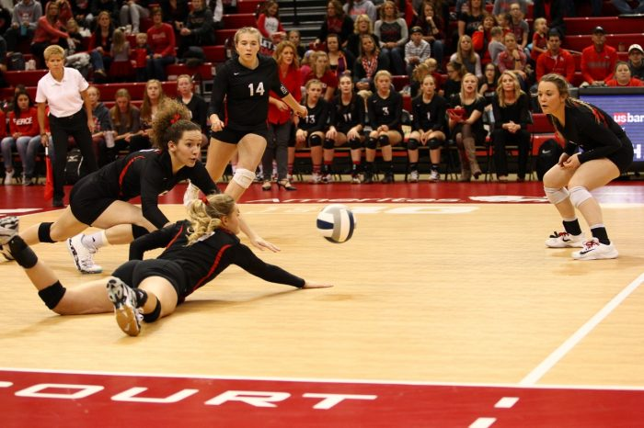
The Court

Slide 20
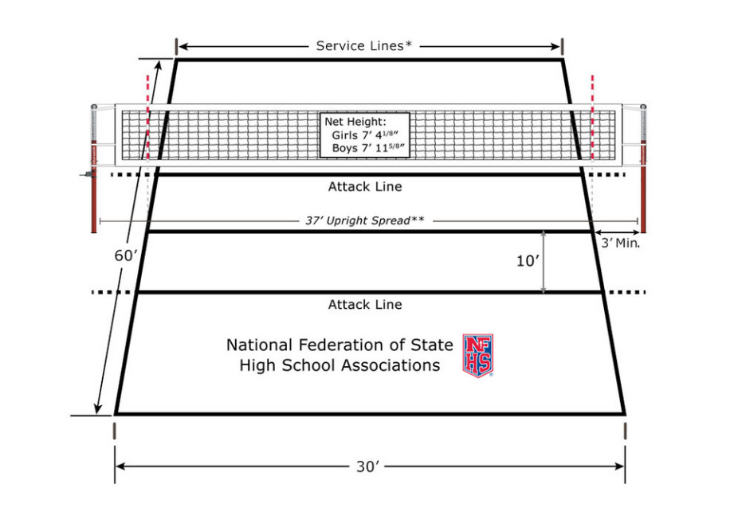

Slide 21
Shall be 60 feet (18 meters) long and 30 feet (9 meters) wide.
The court and adjacent area shall be flat, smooth and free of obstructions.
It is recommended all boundary lines be of one clearly visible color contrasting to the color of the floor and other lines on the floor.
Boundary lines shall be 2 inches (5cm) wide.
A continuous center line, solid or shadow-border, 2 inches (5cm) wide shall separate the court into two equal playing areas.

Slide 22
An attack line shall be solid, 2 inches (5cm) wide and drawn across both playing areas 10 feet (3 meters) from the center line.
A serving area 30 feet (9 meters) wide shall be provided behind the end line.
The substitution zone is the area near the sideline between the center and attack lines.
The libero replacement zone is the area near the sideline between the attack and end lines.
The coaching zone is the area defined as the libero replacement zone and the area beyond the end line.

Slide 23
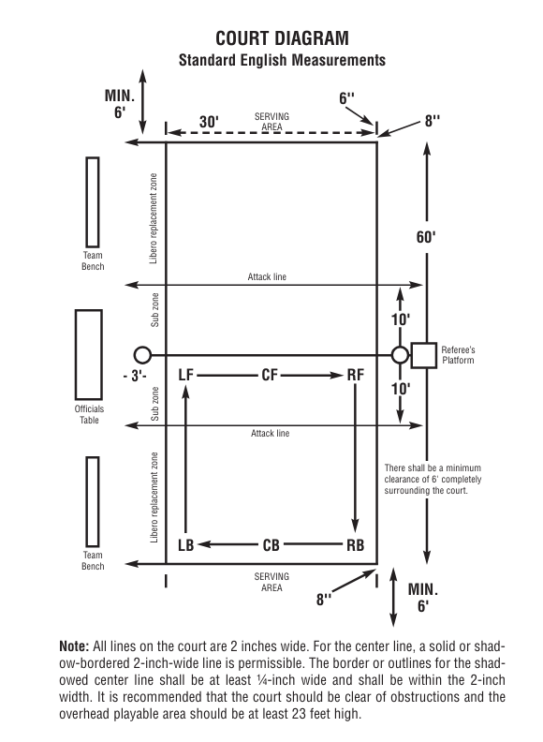

Slide 24
Officials and Crew Common Placement
R1
L1
R1 – 1st Referee
R2 – 2nd Referee
S – Scorer
AS – Assistant Scorer (Libero Control) T– Timer (Scoreboard Operator)
LJ1/LJ2 – Line Judges
L2
R2
Team Bench
T
AS
S
Team Bench
Notes:
Linesperson count starts from right of R1 – L1, L2, L3, L4 being to the left of R1.

Slide 25
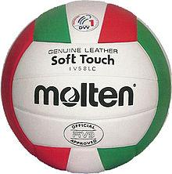
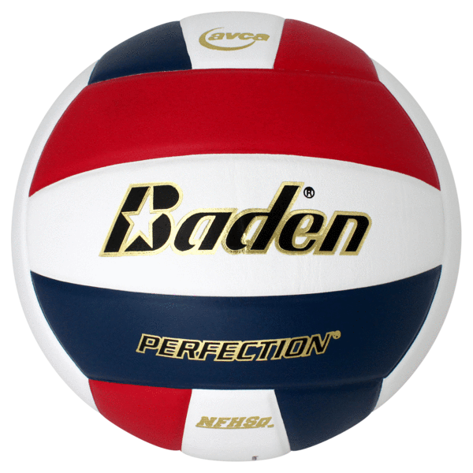
The Ball

Slide 26
Shall have 12 or more basic, rectangular-shaped panels of equal size.
Shall be solid white or a maximum combination of three colors.
Shall measure between 25 – 27 inches in circumference.
Shall be inflated between 4.3 – 4.6 pounds of pressure.
Shall include the NFHS Authenticating Mark in either format

Slide 27
Forms and Tools

Slide 28
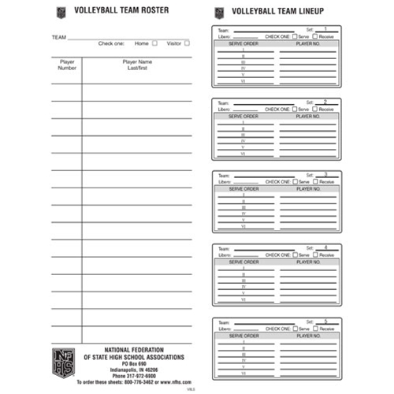

Slide 29
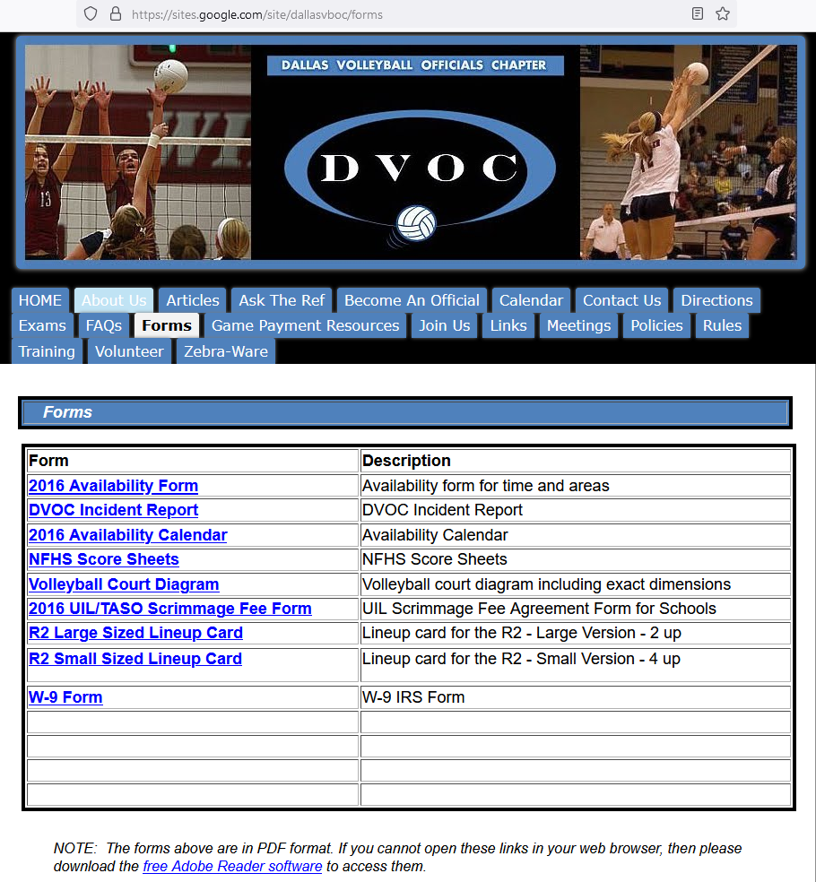
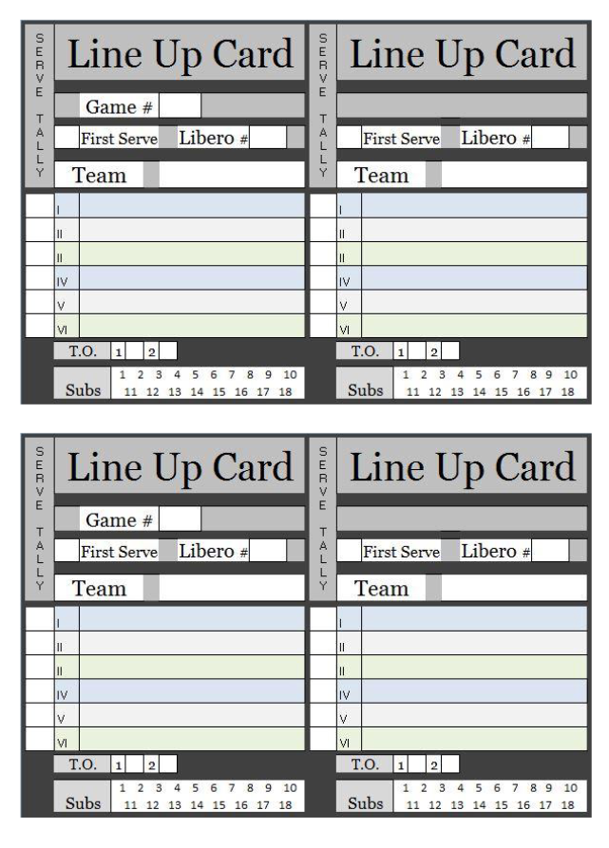
Lineup Card 1

Slide 30
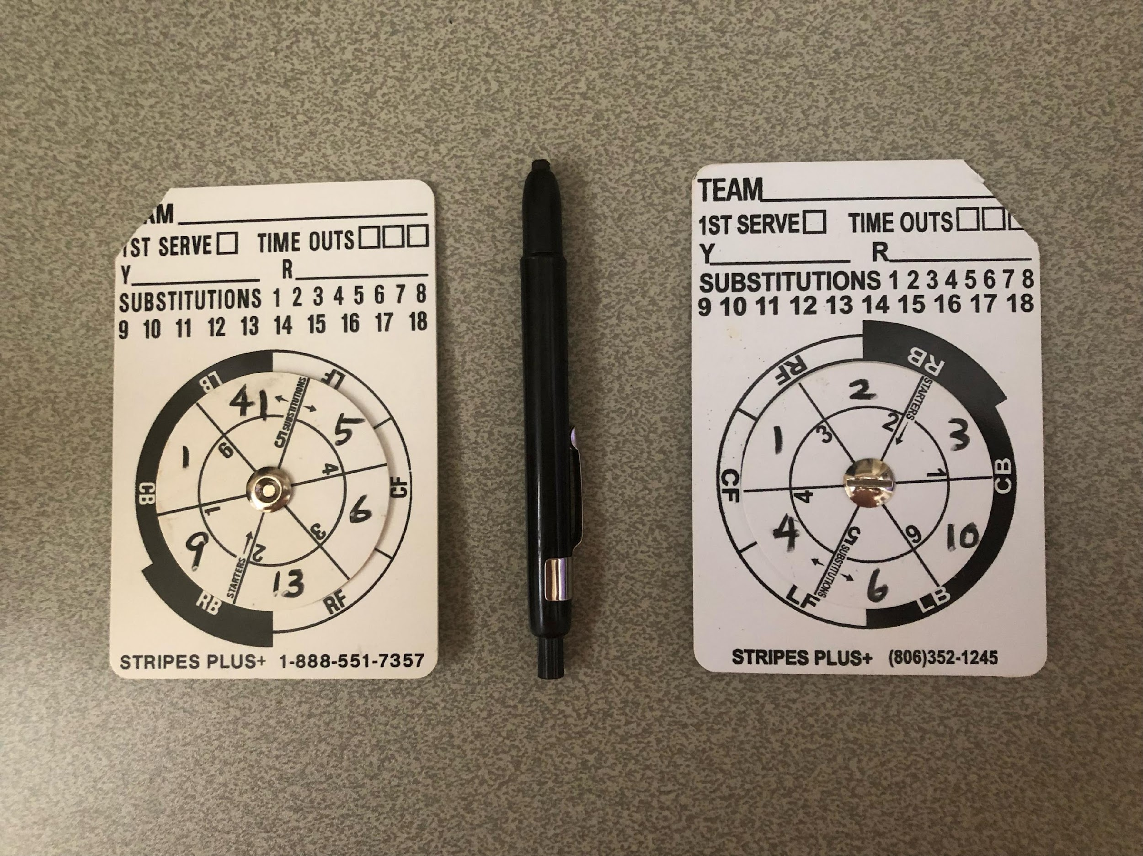
Lineup Card 2

Slide 31
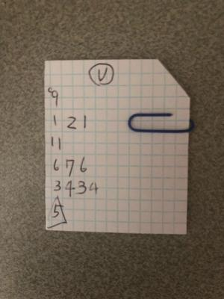
Lineup Card 3

Slide 32
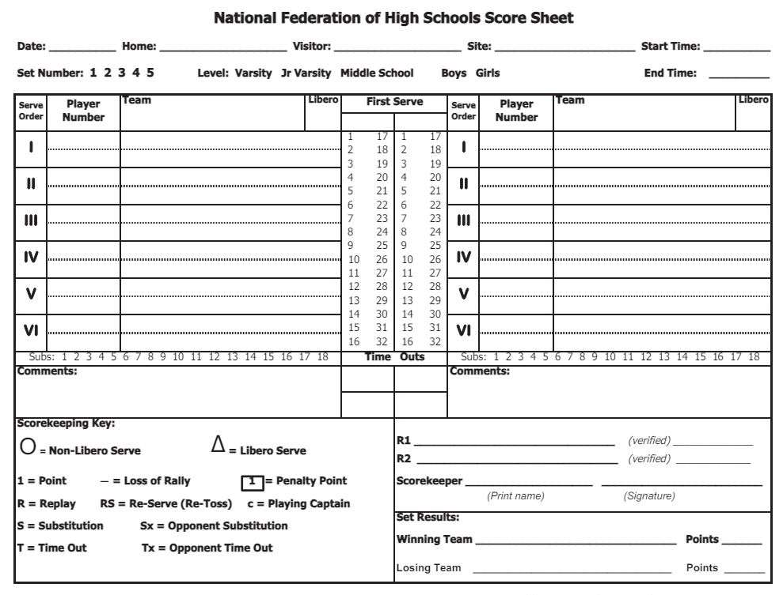

Slide 33
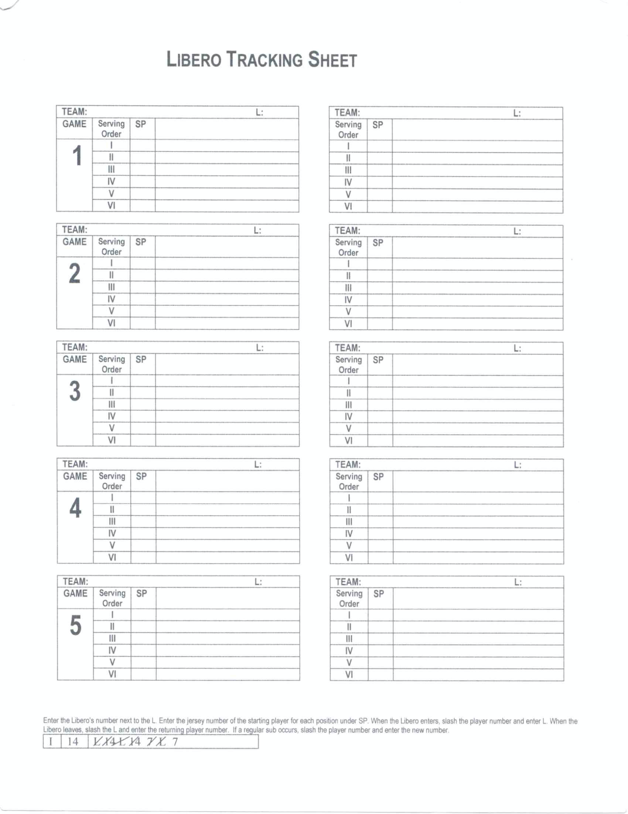

Slide 34
Q&A
This time is for you to ask questions about any of the information that was covered during today’s session.

Slide 35
Keys to Success
The pathway to becoming a successful volleyball referee
Step 2
Step 4
Be a “lifelong” student of the game
Be daring …accept to work at a higher level and excel
Step 1
Step 3
Be a student of the game and know the rules
Accept constructive criticism and learn from your mistakes

Slide 36
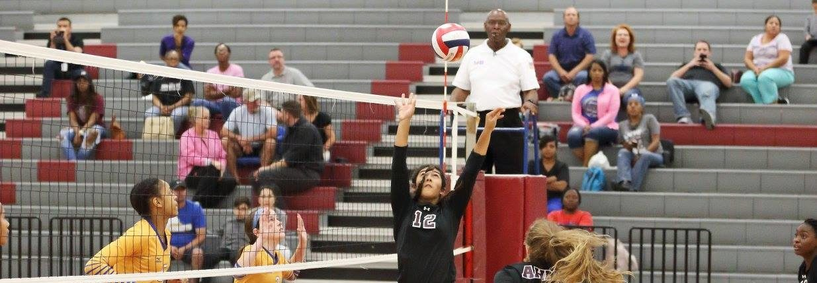
Thank you for attending Session 1 of the 2024-25 DVOC New Officials Training
Some of the slides are courtesy of Dr. Thomas Hoy

