Slide 1
New Officials Training
Session 2
July 11, 2024

Slide 2
Keys to being a Good Official
Officials must referee by the Official Rule Book.
Facilitate the match without bias and don’t dictate the match.
Know the rules and be aware of examples from the case book.
Be consistent with protocols, judgment, sanctions and warnings.
Don’t make up calls even if you missed one earlier.
Be impartial, trust yourself and your crew, and stay on the stand.
Referee 1(R1) and Referee 2(R2) duties are not complete until referees have reviewed Section E of the NFHS Volleyball Officials Manual.

Slide 3
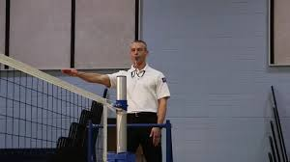
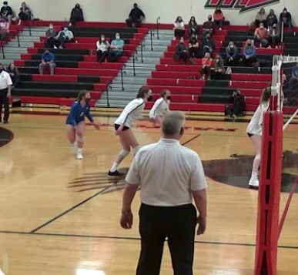
Duties and Roles of Officials
REFEREE 1
R1
REFEREE 2
R2

Slide 4
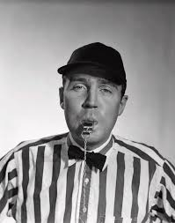
1st Referee | R1 “The Job”
The first referee, also known as the R1, is the official in charge of the match and is responsible for the following duties:
Starting play by whistling and signaling the server to serve the ball.
Facilitating the match from
an elevated stand.
3. Having final say on all calls.

Slide 5
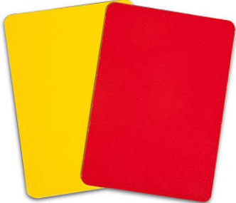
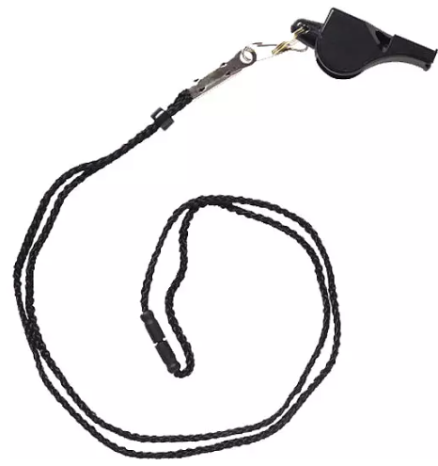
R1 Equipment
Whistle on black lanyard
Red and yellow cards
Coin
Black watch with stopwatch

Slide 6
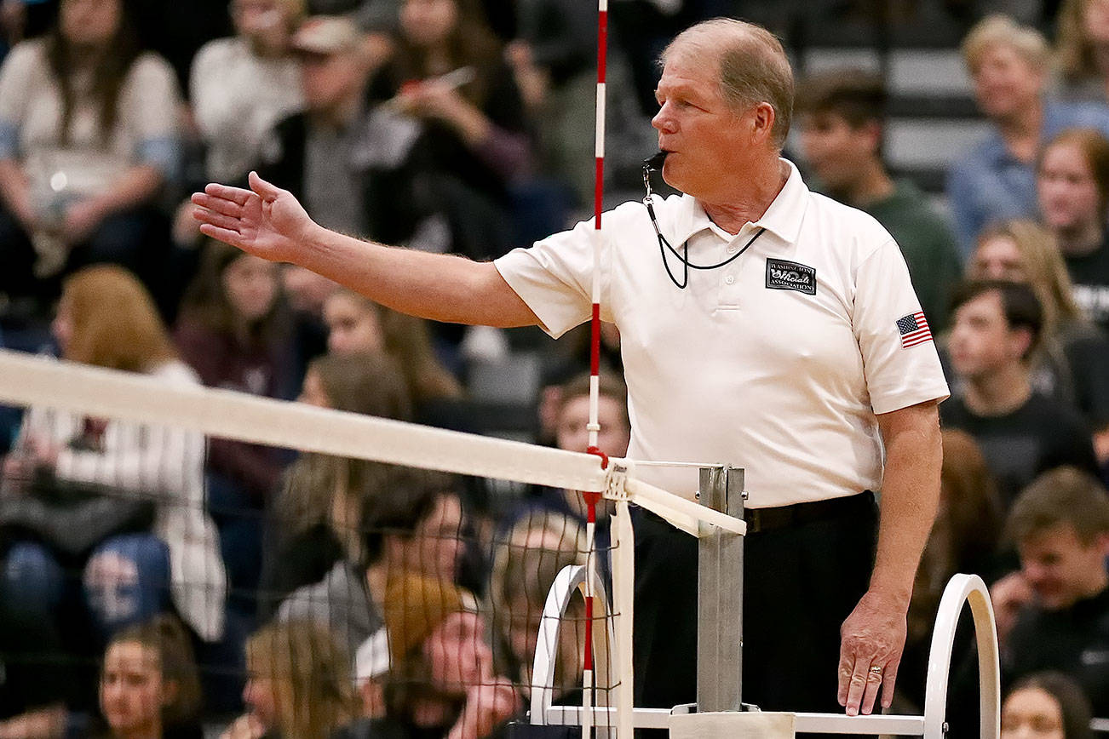
Responsibilities of the R1
Arrival & Pre-game Preparation
Pre-match
Position
Duties
Mechanics
Techniques

Slide 7
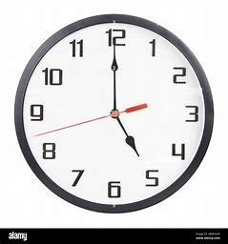
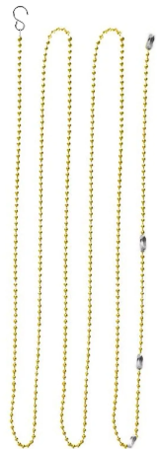
R1 Arrival & Pre-game Preparation
Arrive 30 minutes prior to the start of the match
Turn in match paperwork (TASO match form and W-9)
Identify the administrator on duty and their location
Inspect the court and determine non-playable areas
Confirm the proper height for the net and align antennas
Obtain 2 game balls and check ball pressure
Request line judges from the coaches and instruct them on their role. Keep in mind that only varsity matches have DVOC Line Judges. Our judges for all other matches are student/athletes. Sometimes with little to no experience.

Slide 8
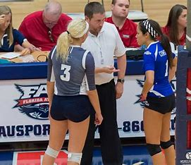
R1 Pre-Match Conference
Call for the Coin Toss. Quickly double blow your whistle and hold your coin up in the air. This is the call for the Captains and Coach for each team to approach the Scorers table.
Introduce yourself and your R2 to the coaches and captains
Explain non-playable areas, discuss flow of the game, ask coaches if they have any special requests/parameters.

Slide 9
R1 Pre-Match Conference cont.
Explain Coin toss procedure and instruct the visiting team to call heads or tails while the coin is in the air. Toss the coin in the air, catch it with your top hand covering, but do not flip your hands over. Lift your top hand and reveal the coin.
The winner chooses to serve or receive first. Identify the serving team. The home team chooses which side they want to start on.
Start warm-up with the team that won the coin toss. Typical warmups for middle school are 4-4-2. Each team gets 4 minutes to warmup then all players serve for 2 minutes.

Slide 10
R1 Position
The R1 is positioned in a stand that places them 2-3 feet above the net so that they can view both sides of the court clearly and equally. The stand is positioned opposite of the scorers table.
The R1 is to stay in the stand for the duration of the match unless there is an emergency.

Slide 11
DUTIES of the R1
Both R1 and R2 are responsible for knowing all NFHS Official Volleyball Signals and Rules. The information below is focused on what a 1st year official should be mastering for middle school matches.
R1 Calls & Signals: - Begin Serve, Line Violation(Serving), Net Serve, Out of Bounds/Antenna Violation on R1 side, Replay/Re-Serve - Ball Lands Inbounds, Ball Touched, Four Hits, Double Hit, Illegal Hit, Point
- Substitution, Time-Out, Official, End of Set, Change of Courts R1 Allows R2 to make the following calls first and then calls if R2 Does Not: - Center Line Violation, Net Fault - Time-Out

Slide 12
Duties of the R1 cont.
Match Facilitation:
- Prior to Start: Blow whistle twice and extend arms out pointing to endlines to have team’s lineup on their respective endline. Blow your whistle one time and bring your hands together in front of your chest. This signals the teams to shake hands/greet.
- Know who your floor captains are. Make eye contact with your line judges to make sure they are ready. Wait for your R2 to signal to give you the court.
- Start the Match and Play the Point (this is the order of a point played).
1. Blow your whistle one time and beckon/call for serve
2. When the ball is down(the floor or wall), blow your whistle one time to indicate the ball is dead
3. Look at your line judges and R2 first and then signal point to the correct team
4. Then signal the fault on the side of the court that the fault was committed
5. Quickly scan the court to make sure no one is hurt or tying their shoes, the Coach is asking for a Time-Out or a substitution request, and to make sure the line judges look prepared for the next point
- Repeat until the set is complete
- Signal the end of the set (cross your arms across your chest), followed by signaling for teams to change sides (swing your arms around your waste, right arm in front and left arm in back).

Slide 13
Duties of the R1 cont.
Match Facilitation cont. :
- Repeat this process until a team wins the match
- End the match
1. When the final ball is down, blow your whistle one time to indicate the ball is dead
2. Look at your line judges and R2 first and then signal point to the correct team
3. Then signal the fault on the side of the court that the fault was committed
4. Signal the end of the match (cross your arms across your chest)
- After Match: Extend arms out pointing to endlines. This signals players to go their respective endline. Blow your whistle and bring your hands together in front of your chest. This signals the teams to shake hands to complete the event

Slide 14
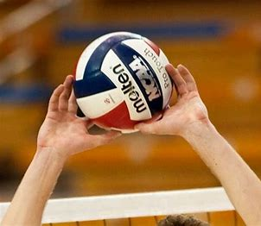
R1 Mechanics
Use proper signals/sequence and hold them high.
Use a loud whistle to show confidence, then gather information with the line judges as needed.
Allow your second referee to whistle first on center line and net faults.
Whistle as soon as the play ends to stop action.

Slide 15
R1 Mechanics cont.
Use the same whistle sound to start and stop play (single).
Use a different whistle sound for interruptions (double).
Use an emergency whistle to stop all players immediately (triple).

Slide 16
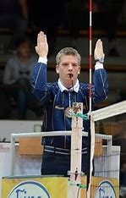
R1 Technique
Before the play of every point the R1 will scan the court and both benches before beckoning for server.
Net Violations
1. R1 signals the team receiving the point (signal #17)
2. Wait for the R2 to signal the number of the player in violation
3. Repeat the number of the player in violation
- Substitutions
1. R2 whistles and signals for substitution (signal #15)
2. R1 does not whistle, but mimics the substitution signal
(signal #15)
3. R1 does not resume play until the R2 gives the court back

Slide 17
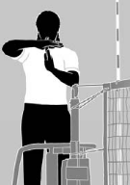
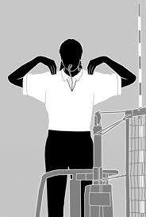
R1 Technique Cont.
- Timeouts
1. R2 whistles and signals which team used a timeout.
2. R1 does not whistle but mimics the timeout signal on the same side of the court as the R2
3. At the end of timeout the R2 signals timeouts used by each team and the R1 mimics this signal.
Unacceptable Spectator Behavior
1. The R1 never directly addresses a spectator
2. R1 takes an Officials Timeout (signals #19 & #19b)
3. Calls over the Administrator and explains explicitly what the spectator
is doing and asks that they handle it in whatever manner is acceptable
based on the moment

Slide 18
R1 Best Practices
Get help from the R2 in checking the roster and looking at uniforms.
Make it a habit – whistle, glance at line judges, center with the R2, then signal.
Support and use your crew – line judges, second referee, scorer, assistant scorer (tracker), timer.
At the end, always show your appreciation to the people that helped you.
Leave the facility/gym with your officiating crew together.
Smile and have fun!

Slide 19
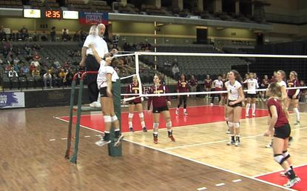
Most noted areas for R1 improvement:
Louder Whistle
Slow down Signals and Hold them Higher/Longer
Separate Signals (1-whistle, 2-winner, 3-fault)
Whistle as soon as play ends
Use pre-serve scan of receiving team before service beckon
Use the correct signal on the correct side
Look confident (even if you are not)

Slide 20
2nd Referee | R2 “The Job”
The second referee, also known as the R2, is just as important as the first referee (R1) and is responsible for the following duties:
Supporting the R1 throughout the match.
Facilitating the match from the floor opposite the R1.
Handling all game interruptions (timeouts,
substitutions), net and centerline violations and
team benches.

Slide 21
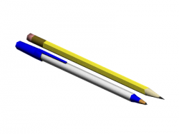
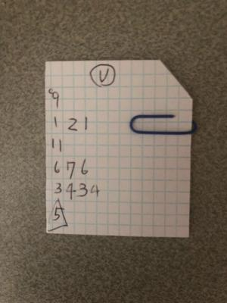
R2 Equipment
Whistle on black lanyard
Red and yellow cards
Coin
Black watch with stopwatch
Lineup cards
Pen/pencil

Slide 22
Responsibilities of the R2
Arrival & Pre-game Preparation
Pre-match
Position
Duties
Mechanics
Techniques

Slide 23
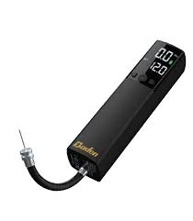
R2 Arrival & Pre-game Preparation
Arrive 30 minutes prior to the start of the match.
Turn in match paperwork (TASO match form and W-9).
Assist the first referee with pre-match duties.
Check net height
Check pressure in the game balls
Help identify playable and non-playable areas
Review duties with the scorer, libero tracker and timer.

Slide 24
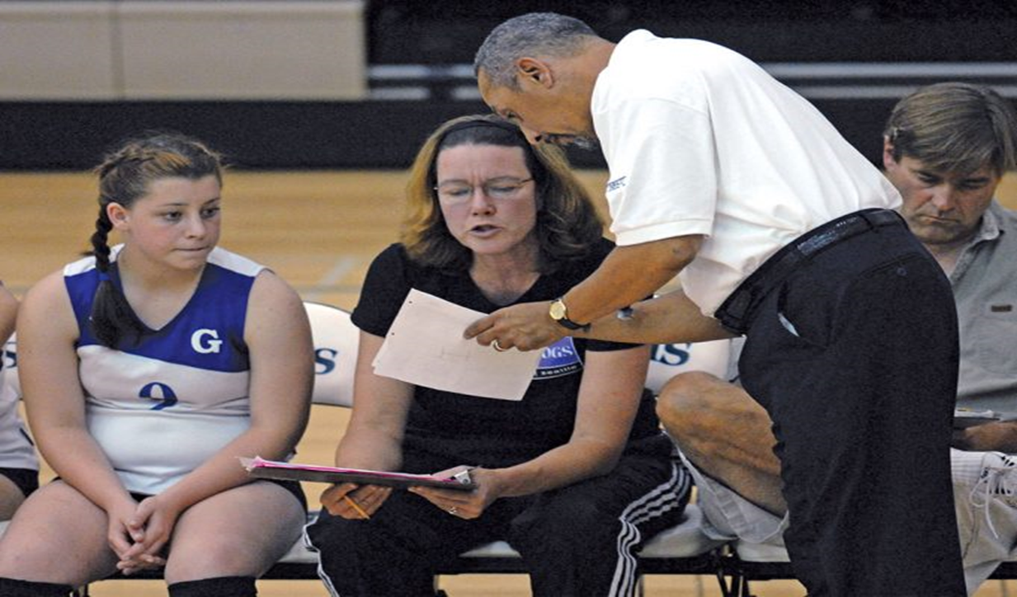
R2 Pre-Match Conference
Collect rosters from both coaches.
Confirm rosters are correct.
Notify scorer which team is serving first.
Ensure each team turns in a lineup with two minutes left in the timed warm-up, one minute between sets.
Confirm that lineups have been entered correctly in the score book and libero tracking sheet.

Slide 25
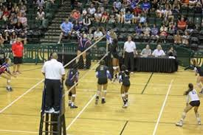
R2 Position
The R2 is positioned on the floor opposite the R1.
At the moment of the serve, the R2 is standing slightly away from the net on the side of the receiving team to view the alignment.
During live play, the R2 will transition to the side of the net opposite the play of the ball to focus on the blockers.
At the end of each play, the R2 will move to the fault side to signal with the R1.

Slide 26
DUTIES of the R2
Both R1 and R2 are responsible for knowing all NFHS Official Volleyball Signals and Rules. The information below is focused on what a 1st year official should be mastering for middle school matches.
R2 Calls & Signals: - Center Line Violation, Net Violation, Antenna Violation on R2 side,
Timeout, Substitution R2 provides discreet signals for violations clearly out of the R1’s view
- Ball Inbounds/Out of bounds, Ball Touched, Four Hits, Double Hit, Illegal Hit R2 allows R1 to make the following calls first and then calls if R1 Does Not: - Back Row Attack, Back Row Block, Unseen ball down (i.e., pancake)

Slide 27
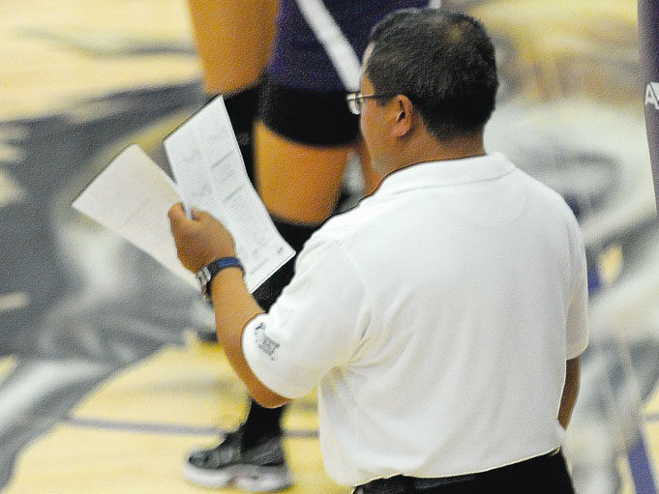
Duties of the R2 cont.
Verifying Lineups:
- Prior to each Set: The R2 stands in the appropriate sub-zone (not on the court) and verifies Position/Numbers for each team on each side.
- Using Lineup Cards
1. Check the receiving team to make sure players are in correct alignment
2. Authorize Libero to enter court
3. Identify the captain to the R1
4. First server will be in Position 2
- Repeat steps above for the serving team. Note : First server will be in position 1.
- Be sure to verify each number on lineup card with player’s jersey number on the court (including Libero).
- Roll ball to server.
- Move to receiving team side.
- Make sure scorer is ready.
- Give ready signal to R1.

Slide 28
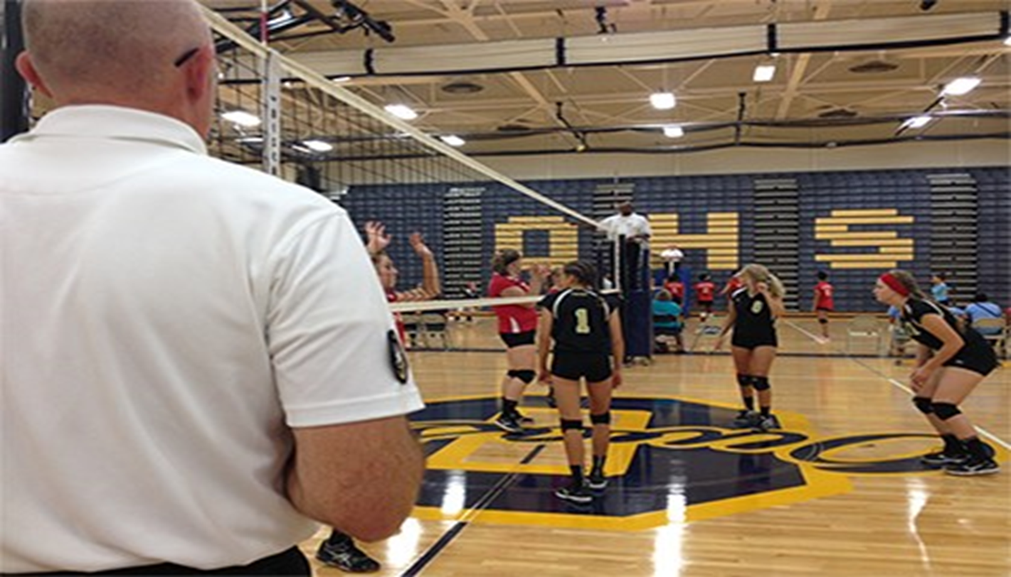
Duties of the R2 cont.
Illegal Alignment / Overlap:
- Prior to each Serve: The R2 is standing parallel with the court on the receiving team side.
- Check the Receiving Team
1. Check to make sure players are in correct alignment
2. Look in the most likely place for a fault
- Two options if fault is identified
1. Warn (if close to illegal alignment — preventive officiating)
2. Whistle and signal a fault
- In either case be prepared to explain what players are out of alignment
to the head coach.
- Use terminology found in the rule book.
1. #2, the setter, left too early
2. #32 CB was closer to the centerline than #20 CF

Slide 29
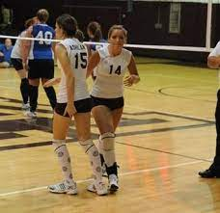
R2 Technique
Substitution (s):
- Substitution Request
1. Sub(s) enter the substitution zone, or head coach makes substitution request
2. Double whistle, then use signal 15
3. If more than one pair of subs, sub them one pair at a time
4. Look for sub request from the other team
5. Repeat steps 1 thru 3 above
- Do not allow the sub(s) to run out onto the court without stopping. - Authorizes each sub to enter court after numbers are clearly identified - On the 15th through 18th substitution, notify the coach the total number of substitutions taken.
- Resumption of Play
1. Make sure scorer is ready
2. Scan benches
3. Give ready signal to R1

Slide 30
R2 Transition Mechanics
Begin on the receiving team’s side of the net for serve, keep your body square to the court, and watch for faults
Once the ball is served or passed, transition quickly to the serving team’s side of the net to watch blockers
Each time you transition, look “through” the net to watch the play develop (R1 may need your help)
At the end of the rally move to the losing team’s side of the net to repeat the R1’s signals
Scan your benches before the next service whistle for sub or time out requests

Slide 31
Additional R2 Mechanics
Mimics all signals given by the R1 (except service beckon and net serve)
Stays with blockers from start until they land/transition
Ensure standing head coach stays 6’ back from sideline during play
Responds to coaches request for lineup check and service order check
Checks the scoresheet for accuracy each time out
Initials the scoresheet after each set to verify results
Notify first referee of any unsporting conduct
In the absence of a timer, time all ‘time outs’ and intervals between sets
Conduct the coin toss prior to the deciding set

Slide 32
More R2 Mechanics
Step away from the pole when giving signals (in view of R1), come to a complete stop, and then give your signal
All discreet signals to R1 are given at the chest
When using discreet signals, step out a little
If R1 looks at you for help, and you have nothing, shake your head “no” – meaning play on
If players are close to illegal alignment, warn the coach to fix it, use preventive officiating whenever possible
If players are wiping the floor, go out and monitor
If a coach yells at the R1, go immediately and intervene

Slide 33
R2 Does Not Use These Mechanics
Watch the server
Follow the ball, not the blockers
Leads the R1 with signals
Not blowing the whistle loud enough
Not giving the ‘ready’ signal to the R1
Not waiting for the sub to enter the sub zone before blowing the whistle
Not waiting for the scorer to complete their work

Slide 34
R2 Does Not Use cont.
Not monitoring and managing team benches
Failing to make eye contact with R1 at end of the rally
Standing behind the pole vs. stepping out some

Slide 35
Basic Instructions on NFHS Hand Signals
NFHS volleyball referees use non-verbal communication to explain to the players, coaches, fans, and co-officials what has happened in a match. This is done through signals that convey who serves next, what faults were made, what sanctions were given, details about interruptions, and other specifics about play, scoring and finishing each set/match.
Referees use these approved signals in a consistent manner so there is no confusion about the communication or call.
Study of signals is not complete until referees have reviewed Section G of the NFHS Volleyball Officials Manual.
Let’s get started!

Slide 36
How to Use NFHS Signals
When stopping play, an official should:
Sound the whistle with authority
Then signal the result of play, point/loss of rally, replay or re-serve
When signaling the violation, hold the hand and arm signal long enough and high enough to be seen
Signals are given with the arm and hand on the side of the team involved (i.e., a fault signal is given on the side of the court where the fault occurred)

Slide 37
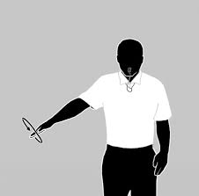
How to Use NFHS Signals
1. Illegal Alignment/Improper Server: Circular motion with the arm and had outstretched on side of violating team, then indicate player(s) involved so the coach can fix it.

Slide 38
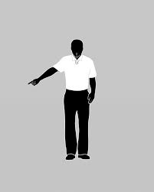
How to Use NFHS Signals
2. Line Violation: Indicate the line where violation occurred by extending arm and pointing toward the line with the index finger.

Slide 39
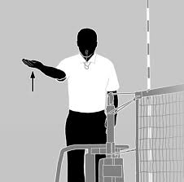
How to Use NFHS Signals
3. Illegal Hit: Slowly lift hand and forearm, palm up from the height of the waist to the height of the chest, on the side where violation occurred.

Slide 40
How to Use NFHS Signals
4. Delay of Serve: Raise hand on server’s side to head height with five fingers spread, palm forward toward the server.

Slide 41
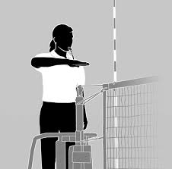
How to Use NFHS Signals
5. Over-the-Net Fault: Pass forearm, palm down, over the top of the net.

Slide 42
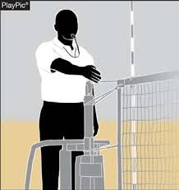
How to Use NFHS Signals
6. Net Fault or Net Serve: Hand of outstretched arm on the side of the net on which the fault occurred (no need to touch the net).

Slide 43
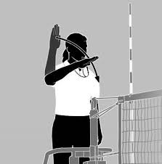
How to Use NFHS Signals
7. Illegal Attack: Raise hand beside head and rotate forearm forward and downward on the offending team’s side of the court.

Slide 44
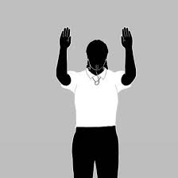
How to Use NFHS Signals
8. Illegal Block/Screening: Raise both hands to head height, palms forward.

Slide 45
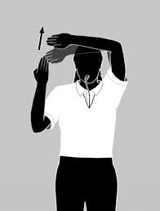
How to Use NFHS Signals
9. Ball Touched: Hand on offending team’s side held beside head, palm toward head (like one-half of an “Out of Bounds” signal #13), then with one short brush upward across fingertips with the other hand, palm forward (brushing forearm/elbow should be above eyes).

Slide 46
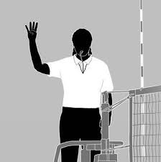
How to Use NFHS Signals
10. Four Hits: Hand and arm on violation side is raised, showing four fingers, with upper arm parallel to the floor.

Slide 47
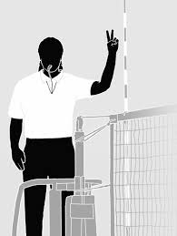
How to Use NFHS Signals
11. Double Hit: Hand and arm on violating team side raised, showing two fingers, with upper arm parallel to the floor.

Slide 48
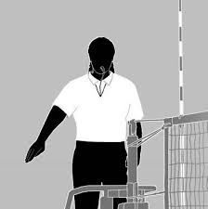
How to Use NFHS Signals
12. Ball Lands Inbounds: Extend one arm with an open hand palm forward toward the floor area where the attack line meets the sideline on the offending team’s side.

Slide 49
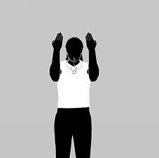
How to Use NFHS Signals
13. Out of Bounds/Antenna Violation: Raise both hands head high, fingers together, palms toward face, elbows bent, and upper arms parallel to the floor.

Slide 50
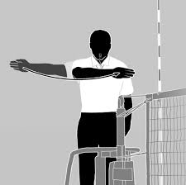
How to Use NFHS Signals
14. Begin Service: After pre-serve scan of the receiving team, extend arm towards server at shoulder height with hand perpendicular to floor, then whistle to serve and move the extended hand and arm in a sweeping motion to the opposite shoulder.

Slide 51
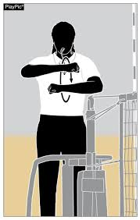
How to Use NFHS Signals
Substitution: After two short whistles, rotate closed fists at shoulder height two times.

Slide 52
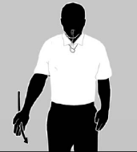
How to Use NFHS Signals
16. Authorization to Enter: Extend the arm (palm forward) on the substitution side of court and make a forward motion ending waist high toward the respective court (symbolically pushing them onto the court). For substitution, but also for the Libero entering prior to the beginning of each set.

Slide 53
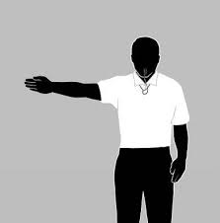
How to Use NFHS Signals
17. Point: Indicate point by extending the arm in the direction of the team that will serve next, palm perpendicular to the floor.

Slide 54
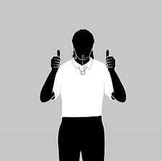
How to Use NFHS Signals
18. Replay/Re-serve: With fisted hands, thumbs up, and held shoulder height in front of body.

Slide 55
How to Use NFHS Signals
19. Time-outs: After two short whistles, place the palm of one hand horizontally over the vertical opposite hand on the side requesting the time-out, forming a “T.”
Team Time-out—followed by indicating court of team being charged (signal #19a).
Official Time-out—followed by tapping the top of shoulders with hands (signal #19b).

Slide 56
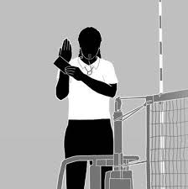
How to Use NFHS Signals
20. Unnecessary Delay: Raise the hand on the side of the offending team beside head, palm facing in, and hold the appropriate card on the outside wrist of the raised hand.

Slide 57
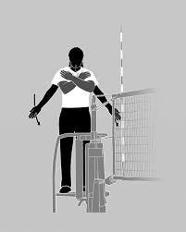
How to Use NFHS Signals
21. End-of-Set: Arms crossed in front of chest; hands open toward chest with fingers together (followed by a sweeping motion to the benches only before deciding set).

Slide 58
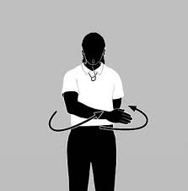
How to Use NFHS Signals
22. Teams Change Courts: Raise forearms and swing right arm in front of body and the left arm in back of body with open hands.

Slide 59
Keys to Success
The pathway to becoming a successful volleyball referee
Step 2
Step 4
Be a “lifelong” student of the game
Be daring …accept to work at a higher level and excel
Step 1
Step 3
Be a student of the game and know the rules
Accept constructive criticism and learn from your mistakes

Slide 60
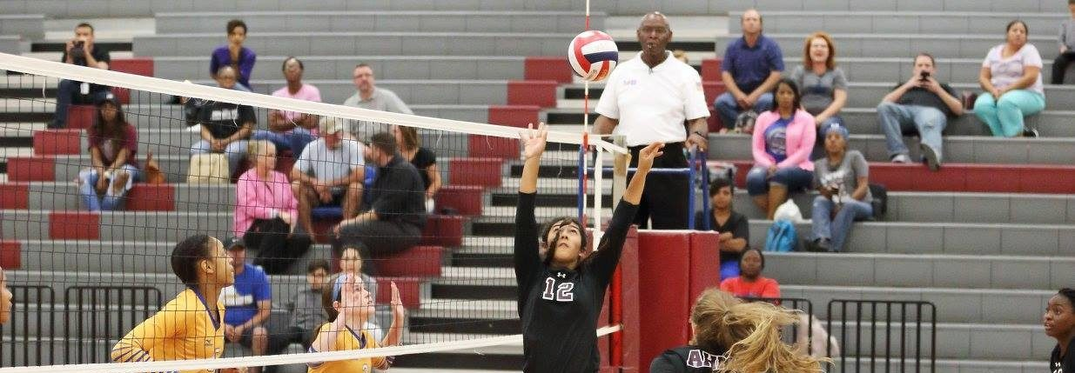
Thank you for attending Session 2 of the 2024-25 DVOC New Officials Training
Some of the slides are courtesy of Dr. Thomas Hoy

